Slide 1
VOC learns how you forget.
VOC
PUBLIC BETA · VOCABRY.UZ
A PERSONAL MEMORY LAB
A vocabulary app for Uzbek-speaking learners of English. It estimates, for every word, how likely you are to remember it — and tells you what to review today.
vocabry.uz
Notes:
VOC is a vocabulary and grammar app for Uzbek-speaking learners of English, now in public beta at vocabry.uz. The key idea: instead of giving everyone the same review schedule, it estimates — for each learner and each word — how likely they are to remember it, and shows them exactly which words to review today.

Slide 2


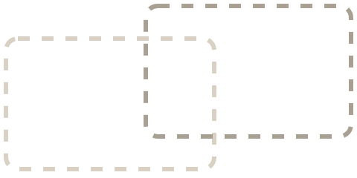
Learning a word does not mean you will remember it
01 · THE PROBLEM
Forgetting is not random — it is personal. Each learner loses different words at a different speed.
Day 1
Day 3
Day 7
Newly learned words feel fresh and easy to recall.
Some words start to fade, and recall gets slower.
Many words are gone unless they were reviewed.
The question VOC answers: which of your words are you about to forget?
VOC · vocabry.uz
02
Notes:
Everyone who learns a language knows this: you learn a set of words, and a week later many of them are gone. On day 1 the words are fresh, by day 3 some fade, and by day 7 the words you did not review are mostly lost. The key point: this is personal. Two learners forget different words at different speeds. So the real question is: which of YOUR words are you about to forget? That is what VOC is built to answer.

Slide 3
A fixed schedule treats every learner the same
01 · THE GAP
VOC replaces "review on day 1, 3, 7" with an estimate made for you, word by word.
 | FIXED REVIEW SCHEDULE | VOC
When to review | Same intervals for everyone | Scheduled for you, word by word
What it learns from you | Right or wrong | Answer history, confidence, answer type (typed or chosen), number of reviews, overall accuracy
What you see | Whatever cards are due today | The words at risk of being forgotten
Result | Generic practice | Practice aimed at your weakest words
VOC · vocabry.uz
03
Notes:
Many learning tools use a fixed review rhythm — review a word after 1 day, then 3, then 7. That assumes every learner and every word behave the same. VOC instead learns from each learner's answers: their history with each word, how confident they are (estimated from answer speed), whether they typed the answer or chose it from options, how many times they have reviewed the word, and their overall accuracy. What the learner sees is simple: the words that are at risk of being forgotten. So practice time goes to the words that actually need it.

Slide 4
How VOC measures your memory
02 · THE SOLUTION
Signals from every answer go in. A simple status for each word comes out.
INPUT SIGNALS
Word history
Every past answer for this word
WHAT YOU SEE
MEMORY MODEL
Answer speed
A clear status
Confidence is estimated from it
One estimate per word
→
→
Strong
Active recall
How likely you are to remember it. Updated after every answer.
Typing the answer beats choosing it
Weak · review today
Number of reviews
At risk
How often you have met the word
Overall accuracy
How well you do across all words
VOC · vocabry.uz
04
Notes:
Three steps. First, the inputs: for every word VOC uses the learner's full history with that word, how fast they answer — we estimate confidence from speed, we don't ask for it — whether they typed the answer or chose it from options (typing is stronger evidence of real memory), how many times they have reviewed it, and their overall accuracy. Second, the memory model turns these into one estimate per word: how likely the learner is to remember it, updated after every answer. Third, the learner doesn't see numbers or jargon — just a clear status like "Strong", "Weak · review today" or "At risk".

Slide 5
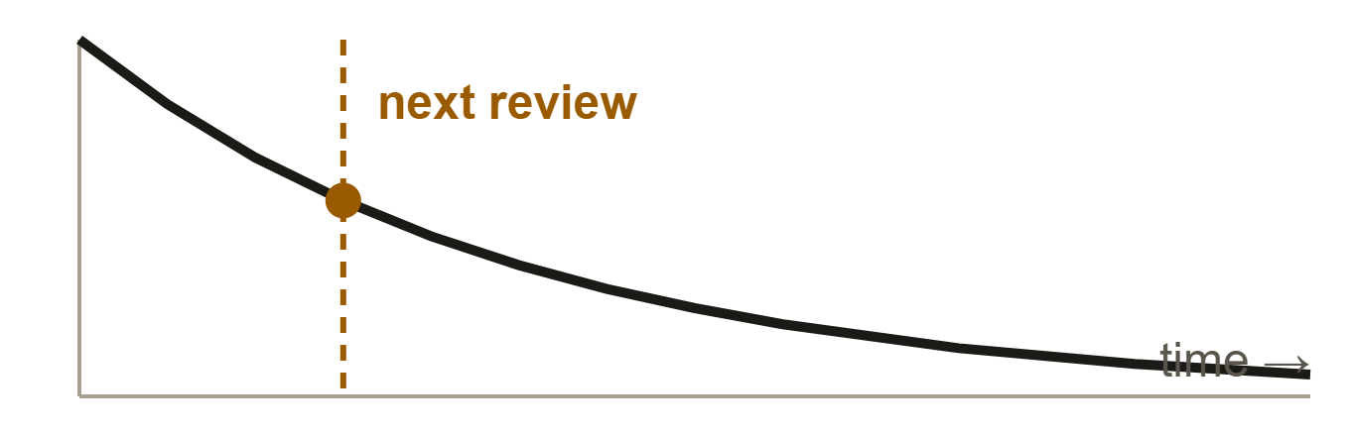
How it works, and how accurate it is
02 · THE MODEL
1 · CHANCE OF REMEMBERING
2 · WHEN TO REVIEW
A calibrated estimate from your history
A forgetting curve sets the schedule
Calibrated means the numbers match reality: of the words marked 70%, about 70% are remembered.
Formula P(t) = e^(−t / S) is used only to pick the next review date — not to judge what you know.
0.78
AUC on learners the model never saw
random guess = 0.50
VOC · vocabry.uz
05
Notes:
There are two separate parts. Part one, the important one: the chance that a learner remembers a word is a calibrated estimate computed from that learner's own history. Calibrated means the numbers can be trusted — of all the words the model marks at 70%, roughly 70% are actually remembered. We tested it on learners the model had never seen, and it scored an AUC of 0.78; a random guess scores 0.50. Part two: to decide WHEN to show a word again, we use a standard forgetting-curve formula, P of t equals e to the minus t over S. That formula is only used for scheduling — it is not how we judge what the learner knows.

Slide 6
Early results from the public beta
02 · EVIDENCE
40+
37,000+
24
0.78
active learners in the beta
real reviews analysed
learners in the test — 8 of them never seen by the model
AUC on unseen learners (random guess = 0.50)
What 0.78 means
An honest note
Take one word a learner remembered and one they forgot. The model ranks them correctly 78% of the time. A coin flip gets 50%.
Our first model did worse than a simple average. We measured it, found the cause and fixed it. Full story on our blog.
Limitation: small sample — early results.
VOC · vocabry.uz/blog
06
Notes:
These are real numbers from our public beta. We have more than 40 active learners. We analysed over 37,000 real reviews from 24 learners, and we kept 8 of those learners completely hidden from the model during training. On those unseen learners the model reached an AUC of 0.78. In plain words: if you take one word a learner remembered and one they forgot, the model ranks them correctly 78% of the time — a coin flip would get 50%. One honest note: our first model actually did worse than a simple average. We only found that out because we measured it properly, and then we fixed it — the full story is on our blog. And the limitation: this is a small sample, so these are early results, not final proof.

Slide 7
How VOC learns you
02 · ONE ANSWER, STEP BY STEP
Every answer is a signal. The more you use VOC, the better it knows your memory.
1 · YOU ANSWER
2 · VOC UPDATES
3 · RESULT
although
Your memory model
Strong
→
→
Speed
1.2 s
Combines this answer with your full history for the word.
Next review:
Answer type
Typed
in 3 days
Confidence
High (from speed)
VOC · vocabry.uz · example values
07
Notes:
One interaction, step by step. The learner is asked for "although" and types the correct answer in 1.2 seconds. We don't ask how confident they are — we estimate confidence from their speed, and a fast answer means high confidence. VOC combines this with the learner's full history for the word. The result the learner sees is simple: the word is "Strong", and the next review is in 3 days. These values are an example.

Slide 8
Same scheduling quality, different product
03 · HOW WE COMPARE
On scheduling we are on par with open-source FSRS-6. We don't claim to beat it — our edge is what we build around it.
 | Anki | Duolingo | VOC
Built for | Self-directed learners who build their own decks | Casual learners on a set course | Uzbek speakers learning English, and their teachers
Review scheduling | FSRS (open source) | Own closed model | Calibrated model, on par with FSRS-6
What the learner sees | Cards plus detailed statistics | Lessons, streaks, points | A status for every word: "Weak · review today"
Teacher / centre panel | No | Duolingo for Schools | Yes: groups, homework, join by QR — our revenue (B2B2C)
VOC · vocabry.uz
08
Notes:
How do we compare to Anki, Duolingo and FSRS? Let's be honest. On the core scheduling problem, our model performs on par with FSRS-6, the open-source scheduler used in Anki. We do not claim to be better. Our difference is everything around the model. First, a separate estimate for every word, shown to the learner as a simple status like "Weak · review today". Second, a simple interface built for Uzbek-speaking learners of English, not for power users who build their own decks. Third, a teacher and learning-centre panel — that's our B2B2C model: centres pay, their students learn.

Slide 9
Four parts, one memory model
03 · THE PRODUCT
01 · LEARNER
02 · LEARNER
03 · LEARNER
04 · TEACHER / CENTRE
Review
Grammar & tests
My Words & Results
Group panel
Weakest words first, so practice starts where forgetting is closest.
Short adaptive tests that check grammar inside real sentences.
Every word's status, the words at risk, and progress over time.
Group status, homework, and students join with a QR code or PIN.
although
Conjunctions
12 words
Revenue
Weak · review today
78% mastered
at risk this week
centres pay for this
MEMORY MODEL
One estimate per word, shared by all four parts
VOC · vocabry.uz · example values
09
Notes:
The product has four parts, all running on one memory model. Review is the core: it always starts with the learner's weakest words — for example "although", marked "Weak · review today". Grammar and tests check grammar inside real sentences. My Words and Results show every word's status, which words are at risk, and progress over time. And the fourth part is the teacher and learning-centre panel: group status, homework, and students join with a QR code or PIN. That panel is where our revenue comes from. The values shown are examples.

Slide 10
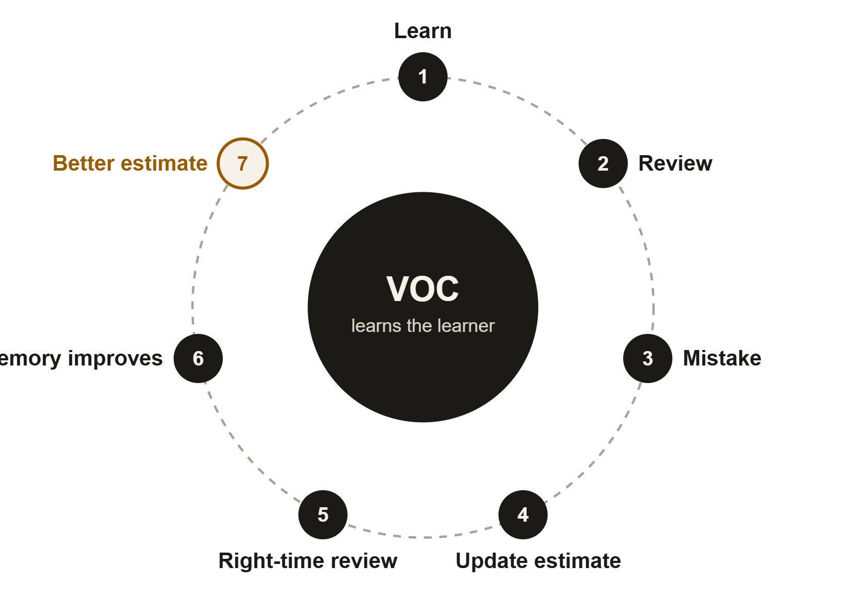
Every answer makes both sides better
03 · THE FEEDBACK LOOP
The learner improves
Steps 1–6: learn, review, make mistakes, and get each word back at the right time — so it sticks.
VOC improves
Step 7: every answer, including every mistake, makes the next estimate for this learner more accurate.
Every mistake teaches the learner.
Every answer teaches VOC.
VOC · vocabry.uz
10
Notes:
This loop is why VOC gets better over time. Follow the circle: you learn a word, review it, sometimes make a mistake; VOC updates its estimate for that word, brings it back at the right time, and your memory of it improves. At the same time — step 7 — every answer, especially every mistake, teaches VOC more about how this learner forgets, so the next estimate is more accurate. Both sides improve together.

Slide 11
Free for learners, paid by centres and schools
04 · BUSINESS MODEL
B2B2C: learning centres and schools pay; their students learn for free.
01 · LEARNERS
02 · PLATFORM
03 · CENTRES & SCHOOLS
Free
VOC
Paid licence
Anyone can use VOC at no cost. No barrier means wide adoption — and more data to improve the model.
→
Memory model
Vocabulary & grammar
Word status & results
Teacher / centre panel
→
Learning centres, schools and universities pay for the panel: group status, homework, progress.
VOC · vocabry.uz
11
Notes:
Our model is B2B2C. Learners use VOC for free — this removes any barrier and every learner also helps the model improve. Revenue comes from learning centres, schools and universities, who pay a licence for the teacher and centre panel: group status, homework and progress tracking for every student.

Slide 12
Start with learners, then sell to centres
04 · GO-TO-MARKET
Free learners prove the model works. Pilot results become the sales case for paid licences.
PHASE 1 · LEARNERS
PHASE 2 · PILOTS
PHASE 3 · PAID
Uzbek-speaking learners of English
Free pilots at learning centres
Paid licences
Who: learning centres, schools, universities.
Who: students at schools, universities and language courses.
→
Who: private language and exam-prep centres.
→
How: pilot results become case studies; licence per student or per centre.
How: teachers use the group panel for a term; we measure retention.
How: free app, website, blog, joining through their teacher.
VOC · vocabry.uz
12
Notes:
Our go-to-market has three phases. Phase 1: Uzbek-speaking learners of English — students at schools, universities and language courses. They reach us through the free app, our website and blog, and through their teachers. Phase 2: free pilots at learning centres — teachers use the group panel for a term, and we measure how much more their students retain. Phase 3: those pilot results become case studies to sell paid licences to centres, schools and universities.

Slide 13
What is working now, and what comes next
04 · CUSTOMER ACQUISITION
Low-cost, organic channels first. Paid ads only once we know what converts.
LIVE NOW
PLANNED
Website
Telegram bot
vocabry.uz — sign-up and public beta
Daily word and quick quiz, linked to the app
Blog
Referrals
Articles on memory and our honest results
Invite a friend, both get a reward
Join by QR / PIN
Shareable report
A teacher shares one code, the whole group joins
Weekly progress card learners can post
Analytics
Short videos
We see which channels bring active learners
Memory tips on Reels, TikTok and Shorts
VOC · vocabry.uz
13
Notes:
We separate what is already live from what is planned. Live now: our website vocabry.uz with the public beta; a blog with articles about memory and our results; joining by QR code or PIN — a teacher shares one code and the whole group joins at once, which is our strongest channel into classrooms; and analytics, so we know which channels bring learners who stay active. Planned next: a Telegram bot with a daily word and quiz, a referral programme, a shareable weekly progress report, and short videos with memory tips. We only move to paid ads once we know what converts.

Slide 14
Where we are, and what comes next
05 · ROADMAP
NOW · LIVE
NEXT
LATER
Public beta
Prove and explain
Personal memory model
v1.0.0-beta.1
the next two milestones
the long-term vision
Calibrated memory model
Teacher / centre panel
Website and blog
Validate the review schedule on more learners
Diagnosis: show why a word is forgotten
How you learn and recover
Learning paths built for you
VOC · vocabry.uz
14
Notes:
Where we are today: VOC is live as a public beta, version 1.0.0-beta.1, with the calibrated memory model, the teacher and centre panel, and our website and blog. Next, two milestones: first, validate that our review schedule actually improves long-term memory, on many more learners; second, diagnosis — showing the learner why a word is being forgotten. The next two slides show what diagnosis will look like. Later, the long-term vision: a full personal memory model that understands how each person learns and recovers, and builds a learning path just for them.

Slide 15
Diagnosis: finding out why you forget
05 · NEXT STAGE
NOT IN THE APP YET
01
02
03
04
Detect
Diagnose
Intervene
Re-estimate
Notice a failed or very slow answer.
Rank the most likely reasons it was forgotten.
Pick the practice that fixes that exact reason.
Update the word's status and next review.
Today VOC shows which words are at risk. Next, it will show why.
VOC · vocabry.uz
15
Notes:
This is our next stage, and it is not in the app yet. Today VOC shows which words are at risk. Next, we want it to explain why. The plan has four steps: detect a failed or very slow answer; diagnose the most likely reasons; choose a practice type that targets that reason; and re-estimate the word's status and next review date. The next slide shows an example of how this could look.

Slide 16
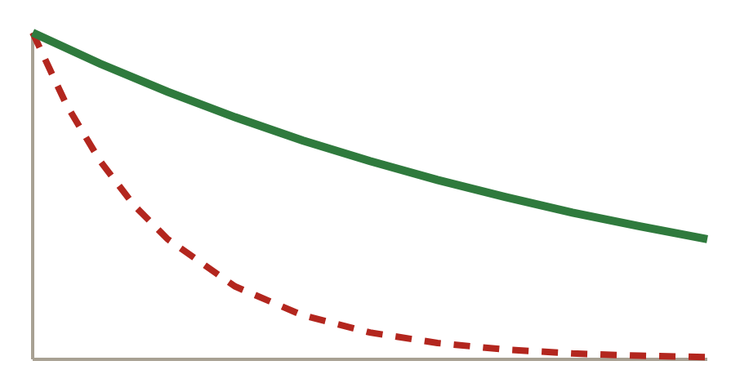
A learner forgets "although"
05 · NEXT STAGE · EXAMPLE
PLANNED
LIKELY CAUSES
PLANNED FIX
EXPECTED EFFECT
Estimated, not validated
Contrastive drill
Confused with a similar word
42%
Practise "although" next to the word it gets mixed up with, until the difference is automatic.
Review gap too long
31%
Weak confidence history
18%
He decided to go ___ the heavy rain.
━━ After the drill: slower forgetting
Too little exposure
9%
despite ✓ + noun · although + clause
- - - Before: slipping fast
VOC · vocabry.uz · illustrative, not validated
16
Notes:
Here is how diagnosis could work, using the word "although". To be clear: this is planned, and the percentages are estimates that have not been validated. The diagnosis would say the most likely cause is confusion with a similar word, then a review gap that was too long, then weak confidence history, then too little exposure. Because confusion is the top cause, VOC would offer a contrastive drill: practising "although" next to "despite". For example, "He decided to go ___ the heavy rain" — the answer is "despite", because "despite" takes a noun, while "although" takes a full clause. The chart is illustrative: we expect the word to be forgotten more slowly after the drill. This drill has not been built yet.

Slide 17
What we don't know yet
05 · RISKS
Does the model hold at scale?
Results come from 24 learners. We need to confirm them on a much larger group.
Does the schedule help?
Not yet tested: does our review schedule improve long-term memory compared with a fixed one?
Will centres pay?
The panel is live, but price and pilot-to-paid conversion are not proven yet.
Will learners stay?
Beta users are active, but we have not yet measured retention over many months.
Will diagnosis change behaviour?
Showing why a word is forgotten must lead to better practice — still to be tested.
VOC · vocabry.uz
17
Notes:
We want to be open about what we have not proven yet. One: our model results come from 24 learners — we need to confirm them on a much larger group. Two: we have not yet tested whether our review schedule improves long-term memory compared with a simple fixed schedule. Three: the teacher panel is live, but we have not yet proven the price centres will pay or how many pilots convert to paid. Four: beta users are active, but we have not measured retention over many months. Five: diagnosis must actually lead to better practice — that is still to be tested. Each of these is a milestone in our plan.

Slide 18
The people building VOC
06 · TEAM
AA
XA
Asadbek Abdukaxxarov
Xolmirzayev Azimjon
DESIGNER
PRODUCT MANAGER
UX/UI, visual design and design systems.
Product strategy, learning systems and roadmap.
VOC · vocabry.uz
18
Notes:
VOC is built by our team. Asadbek Abdukaxxarov is the designer — UX/UI, visual design and the design system. Xolmirzayev Azimjon is the product manager — product strategy, the learning system and the roadmap.

Slide 19
Who we will hire next, in order
06 · NEXT KEY HIRES
The model is built and measured. Next: prove it at scale, grow the product, and sell it.
01 · FIRST
02
03
04
ML / data engineer
Mobile / full-stack engineer
Growth & partnerships lead
Learning content lead
Tests and improves the model on much more data.
Ships the app and the teacher panel faster.
Runs pilots with centres and schools.
A linguist or teacher who designs word lists and drills.
Why: our results need a bigger sample.
Why: from beta to a stable product.
Why: turns pilots into paid licences.
Why: quality of what learners practise.
VOC · vocabry.uz
19
Notes:
Our model is already built and measured. Our next hires, in priority order: first, an ML or data engineer to test and improve the model on much more data, because our current results come from a small sample. Second, a mobile or full-stack engineer to take the app and teacher panel from beta to a stable product. Third, a growth and partnerships lead to run pilots with learning centres and schools and turn them into paid licences. Fourth, a learning content lead — a linguist or teacher — to design the word lists and drills.

Slide 20
Memory is personal.
VOC — PERSONAL MEMORY LAB
VOC shows every learner which words they are about to forget.
Next, it will show why.
WEBSITE
TELEGRAM
EMAIL
vocabry.uz
@azimjonxolmirzayevs
azimjonxolmirzayev30@gmail.com
Notes:
To sum up: memory is personal. Every learner forgets different words, at different speeds. VOC already shows each learner which words they are about to forget, with a model we have measured honestly. Next, it will show why. Try it at vocabry.uz. Thank you.

